Slide 1
GRAPHICAL USER INTERFACE

Slide 2
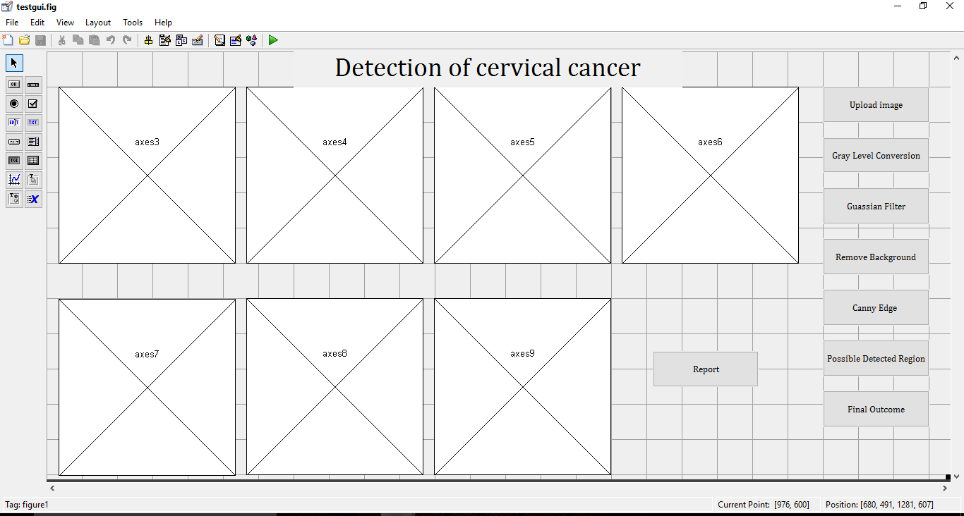
GUI OF THE DETECTION OF CERVICAL CANCER
AXES
STATIC TEXT
PUSH BUTTON

Slide 3
AXES : Axes are the display section of the report from the processed image obtained from the image that was provided as an input. There are multiple axes to provide different analysis of the image that has been fed as the input.
STATIC TEXT: Static text is the header of the analysis and gives the title of the analysis being provided by the axes.
PUSH BUTTON: Push button is the interactive components of the GUI. The operations to be performed using the GUI is accomplished using the Push Buttons

